Slide 1

Chemistry of Life
Properties of Water

Slide 2
The Importance of Water
Water is one of the prime elements responsible for life on earth.
  With two thirds of the earth's surface covered by water and the
  human body consists of 75 percent of it.
Water is the most abundant molecule present in all living
organisms.
Water circulates through the land just as it does through the
human body, transporting, dissolving, replenishing nutrients and
organic matter, while carrying away waste material.
All chemical reactions within an organism take place in the
presence of water.
Further in the body, it regulates the activities of fluids, tissues, cells,
lymph, blood and glandular secretions.

Slide 3
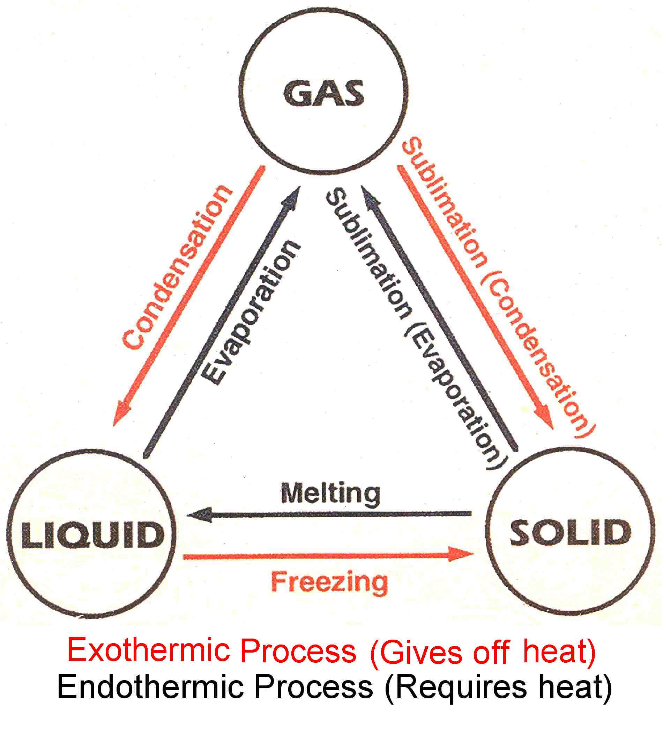
State of Water
Three States of Water:
Liquid (typical)
Solid : ice
Gas : water vapor

Slide 4
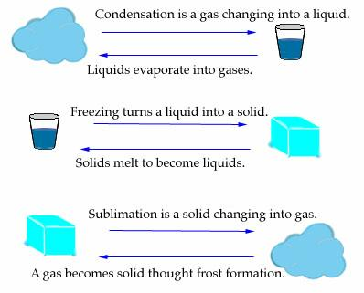
Changes in The States of Water
Below freezing: water is a solid
(ice or snowflakes)
Between freezing and boiling:
water is a liquid, and above its boiling point
water is a gas.
Water changing from solid to liquid
is said to be melting.
When it changes from liquid to gas it is
evaporating.
Water changing from gas to liquid is called
condensation (An example is the 'dew'
that forms on the outside of a glass of
cold soda).
Frost formation is when water
changes from gas directly to solid form.
When water changes directly from solid
to gas the process is called sublimation.

Slide 5
Boiling point and the Melting point.
Two of the more important physical properties of pure substances are the boiling point and the melting point.
The boiling point of a liquid is the temperature at which that liquid
is converted to a gaseous state.
Once the liquid starts to boil, the temperature remains constant until all of the liquid has been converted to a gas.
The melting point is the temperature at which a solid is
converted to liquid.

Slide 6
Importance of Boiling and Melting point
The boiling point of liquids and melting point of solids is
often used for the identification of substances.
Measurements of the melting point of a solid can also
provide information about the purity of the substance.
Pure, crystalline solids melt over a very narrow range of
temperatures, whereas mixtures melt over a broad
temperature range.
Mixtures also tend to melt at temperatures below the
melting points of the pure solids.

Slide 7
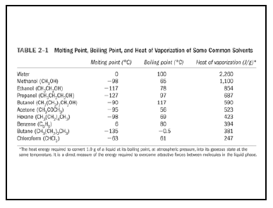

Slide 8
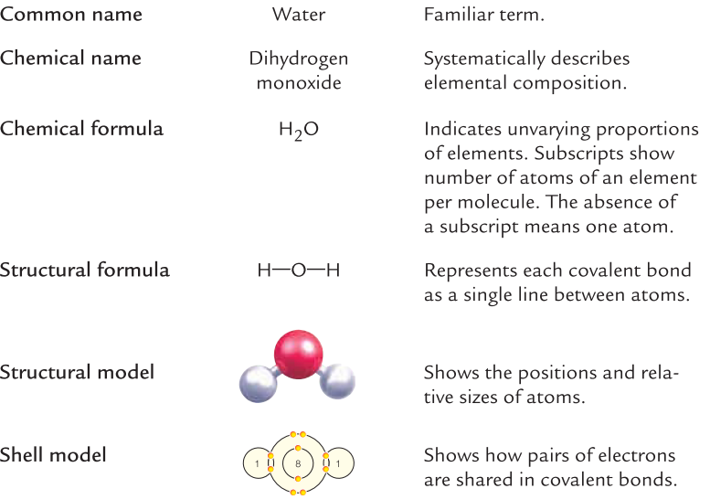
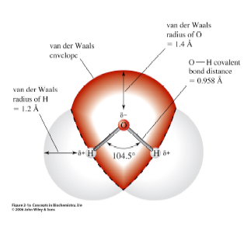
The Water Molecule
The water molecule has a bent geometry with an O – H bond distance of
0.958 A and an H – O – H bond angle of 104.5⁰

Slide 9
Chemical and Physical Properties of Water
Water is Polar
Water is an excellent solvent
Water molecule can spontaneously dissociates into a hydrogen (H⁺) ion and a hydroxide ion (OH–)
Water has cohesive properties
At sea level, pure water boils at 100 °C and freezes at 0 °C.
Adhesion
Less Dense as a Solid

Slide 10
Unique Properties of water that contribute to its vital importance in the processes of life
Water as Universal Solvent
  The polar nature and geometry of water allows water molecules to form hydrogen bonds with each other and with other dissolved hydrophilic substances
  The hydrogen bonds that hold water molecules make water a versatile solvent that can form solutions with polar (hydrophilic) molecules.
  Water cannot form solutions with nonpolar (hydrophobic)
  molecules.
  Solution: homogeneous mixtures of molecules
  Solution = Solvent + Solute
  Solvents: Molecules that dissolve Solutes to form Solution.
  Solutes : Molecules that are dissolved in Solvents to form
  Solution.

Slide 11
Example:
  An aqueous solution of NaCl and water: the solvent is water and the
  solute is NaCl.
  NaCl is ionic, and therefore hydrophilic, and forms an aqueous solution
  in which water is the solvent and NaCl is the solute.
  Oil is nonpolar, and therefore hydrophobic. Oil will not dissolve in water.
Water Ionization
  Occasionally, water molecules spontaneously ionize, or
  Break apart, into hydroxide ion (OH⁻) and hydrogen ion
  (H⁺), as illustrated in the following chemical equation:
H₂O OH– + H⁺

Slide 12
Why Water is referred to as the universal solvent and important for life?
  Water is a very strong solvent dissolving many types of substances.
  Substances that will mix well and dissolve in water, e.g.
  salts, sugars, acids, alkalis, and some gases: especially
  oxygen, carbon dioxide (carbonation), are known as "hydrophilic" (water-loving) substances, while those that do not mix well with water (e.g.fats and oils), are known as "hydrophobic" (water-fearing) substances.
  All the major components in cells (proteins, DNA and
  polysaccharides) are also dissolved in water.
Water As most abundant molecule in life
  A cell of Escherichia coli contains 70% of water.
  Plant body contains up to 90% water
  A jellyfish is made up of 94–98% water.
  A human body contains 60-80% of water.

Slide 13
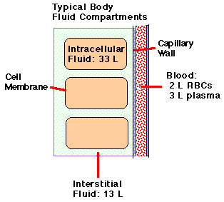
Distribution of water inside human body
- Body 60-80% water by weight
70 kg man has ~ 49 kg water = ~49 L
Human Body is Split Into 3 Solution-
Filled Compartments:
Intracellular (inside cells) = ~ 34 liters
Interstitial (outside cells) = ~ 13 liters
Blood plasma = ~3 liters
Note1: plasma is similar to interstitial fluid, but contains plasma proteins
Note 2: serum = plasma with clotting proteins removed
Note 3: intracellular fluid is very different from interstitial fluid (high K concentration instead of high Na concentration, for example)

Slide 14
Boundaries:
  Capillary walls separate blood from interstitial fluid
  Cell membranes separate intracellular and interstitial fluids
Loss of about 30% of body water is fatal
This can be a problem in the desert
Many diseases involving diarrhea can dehydrate the body to this extent (i.e., cholera)

Slide 15
Solutions & Suspensions
Water is usually part of a mixture.
Because so many things dissolve in water, it is called the Universal Solvent
There are two types of mixtures:
  Solutions
  Suspensions

Slide 16
Properties of Solutions
Ionic compounds disperse as ions in water (+ions & -ions spread out among polar water molecules)
Solutions are Evenly distributed mixtures
SOLUTE
  Substance that is being dissolved
SOLVENT
  Dissolving Substance for the solute

Slide 17
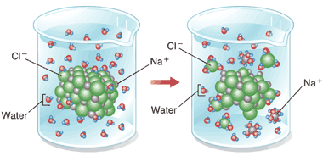
Ionic Solutions
Na+ ions will be attracted to WHAT END of the water molecule?

Slide 18
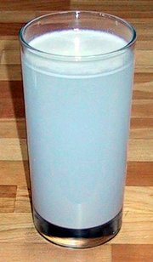
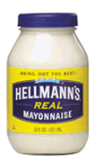
Suspensions
Substances that don’t dissolve but separate into tiny pieces.
Water keeps the pieces suspended so they don’t settle out.
Blood & Cytoplasm are suspensions

